Slide 1


Forecasting National Unemployment Rates
Time Series Analysis using SARIMA Models
OBJECTIVE
CONTEXT
APPROACH
Predict future unemployment trends for UK, France, and Germany to assist in planning.
Unemployment rates are critical economic indicators requiring accurate forecasting
Application of SARIMA models on historical monthly data to account for trends and seasonality.

Slide 2



Methodology
SARIMA FRAMEWORK
SARIMA(p,d,q)(P,D,Q)m
FRAMEWORK: STATSMODELS & PMDARIMA
1. Pre-processing
2. Model Selection
3. Validation
•
Ingestion: Loaded historical unemployment rate data for UK, FR, and DE.
Data sourced from Office of National Statistics (UK) and Eurostat (France and Germany)
•
Split: Training (95%) and Test (5%) sets. Considered period from Jan 1997 to Sep 2025, a period of 345 months
•
Generated in-sample "fitted" values.
•
Produced out-of-sample "forecasts" for the test period.
•
Auto-ARIMA: Stepwise search for optimal parameters, using stepwise AIC optimisation
•
Compared predictions against actual reported rates.
•
Stationarity Check: Applied Augmented Dickey-Fuller (ADF) test.
•
Parameters: Order (p,d,q) and Seasonal Order (P,D,Q,m) with m=12.
•
Result: All data non-stationary (p > 0.05), requiring differencing.

Slide 3
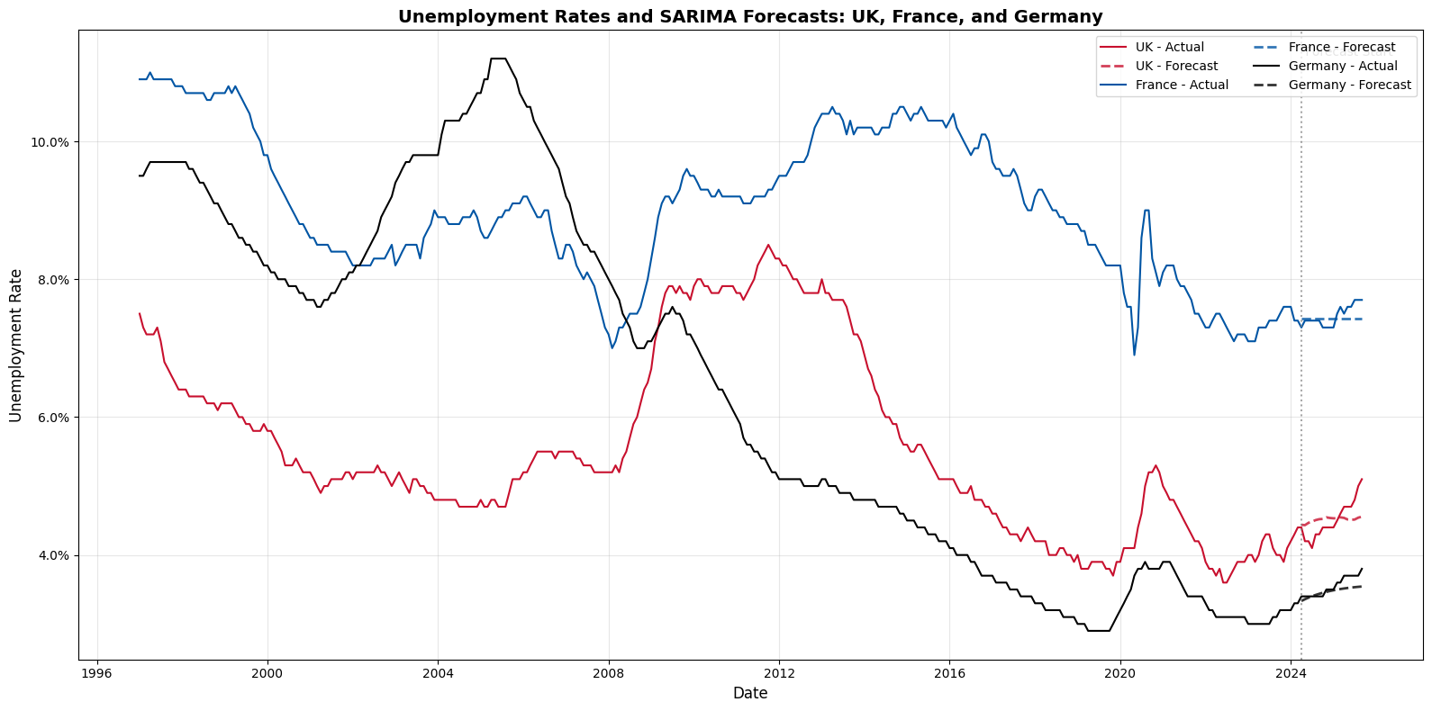
Historical Data & Forecasts
VISUAL ANALYSIS OF UNEMPLOYMENT TRENDS

Slide 4
Evaluation: Goodness of Fit
METRIC: ROOT MEAN SQUARED ERROR (RMSE) - LOWER IS BETTER
Country | Model | In-Sample RMSE | Out-of-Sample RMSE | RMSE Ratio (Out/In)
UK | SARIMA(1, 1, 3)x(0, 0, 2, 12) | 0.0042 | 0.0025 | 0.59
France | SARIMA(0, 1, 1)x(0, 0, 0, 12) | 0.0062 | 0.0015 | 0.24
Germany | SARIMA(1, 1, 2)x(0, 0, 0, 12) | 0.0053 | 0.0012 | 0.22
Key Insights:
All models show lower out-of-sample RMSE than in sample, positive for future forecasting
Model for UK achieved closest fit on training dataset, although the out-of-sample fit for the testing period (of about 1.5 years) was not as close as for France and Germany

Slide 5


Observations & Conclusion
KEY FRAMEWORK TAKEAWAYS
Non-Stationarity Confirmed
ADF tests successfully identified non-stationary data, validating the need for Integrated (I) models and differencing for all regions.
Seasonality is Key
Auto-ARIMA selected seasonal parameters suggesting seasonality in unemployment patterns
Good Model Efficacy
The SARIMA framework is effective for short-term forecasting, with RMSE values below 0.3% across all regions.
Further work
Global Financial Crisis (2008-9) and Covid (2020-22) could have had distortion effects, consider regime-switching models
Consider incorporating exogenous variables and multivariate approach

